Slide 1
United Europe
A perfect home to live in

Slide 2
The first year
Getting to know eachother
Learning about new cultures
Making new friends ☺

Slide 3
October
PPT presentation of our country and school to partners
First meeting- Romania
Comenius notice board in school

Slide 4
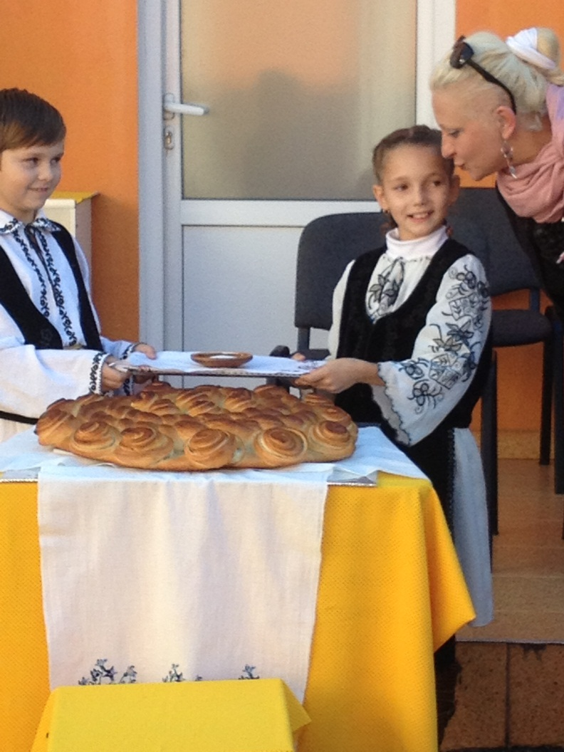
First meeting- Romania

Slide 5

Logo Competition -November

Slide 6
Posters-December
We made poster about all our new project partners and learnt a lot of new and exciting facts!
Did you know?
Sofia is the second oldest capital in Europe
Poland is surrounded by 7 countries
The Parliament building in Bucharest is the second largest building in the world
Latvia has approx 5000 lakes

Slide 7
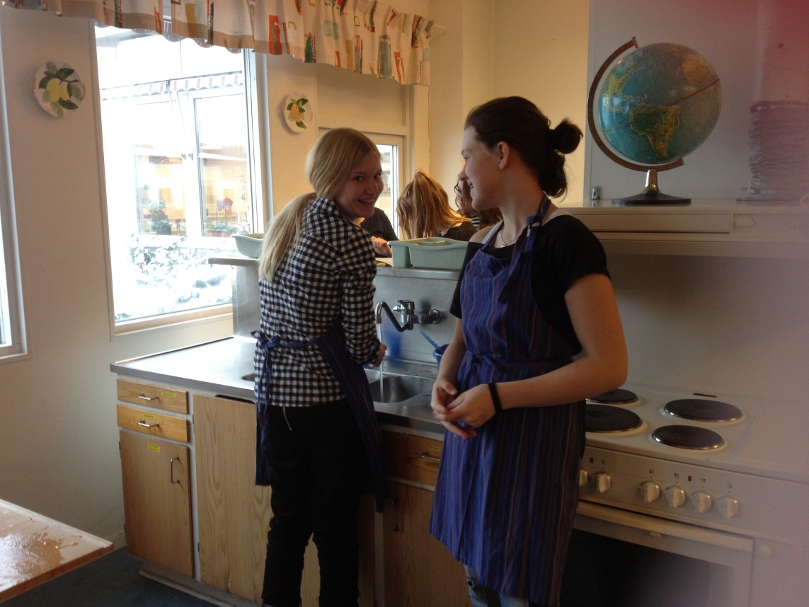
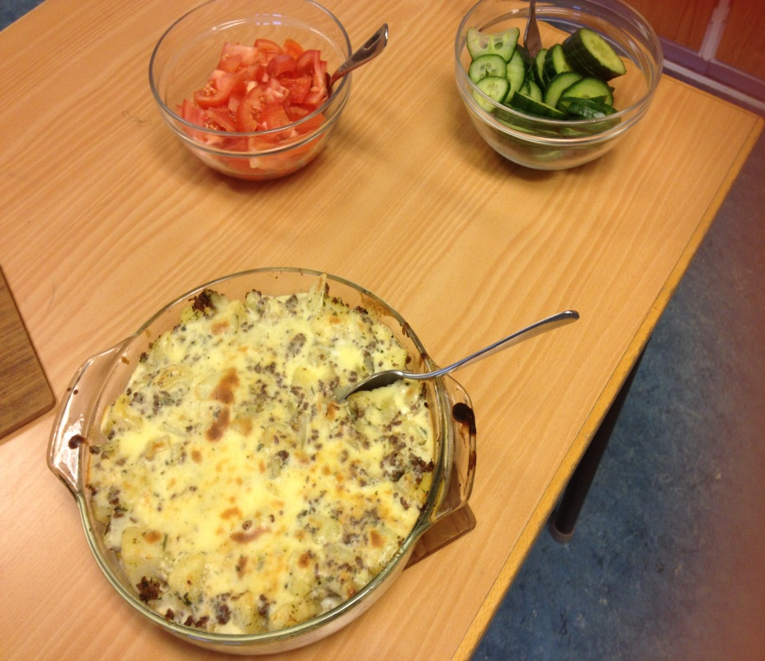
Cooking

Slide 8
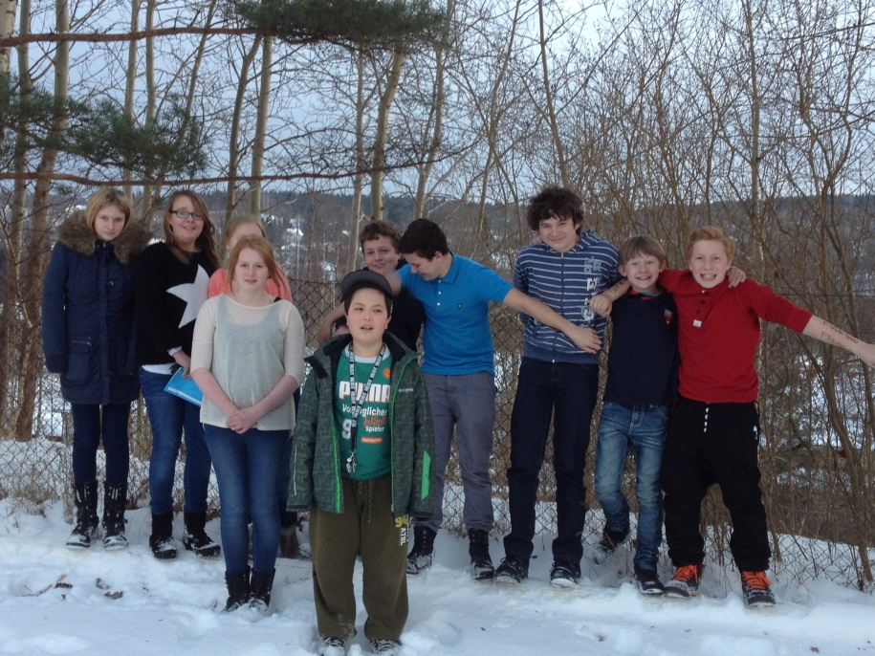
Christmas traditions
We shared recipies and cooked traditional Christmas dishes
We learned many new traditions
We exchanged Christmas cards

Slide 9
February
Started working on e-vocabulary
PPT educational systems
First newletter was produced
First article in local newspaper

Slide 10
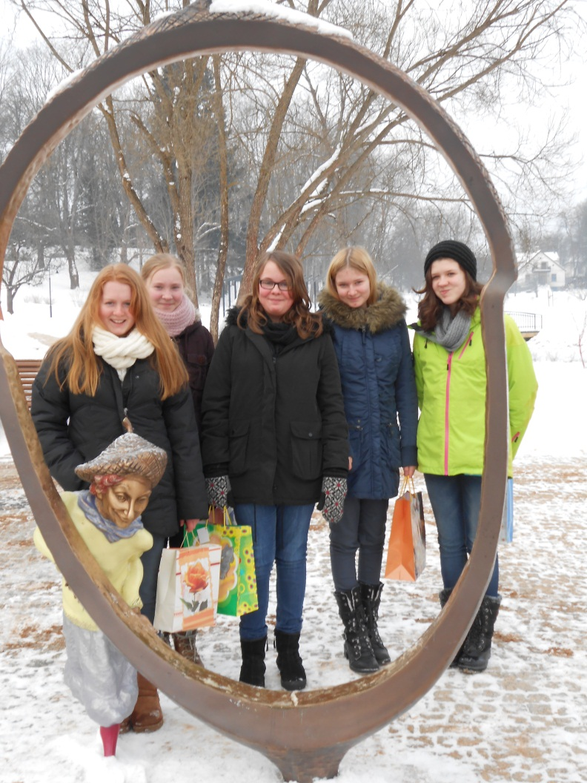
Second meeting-Latvia

Slide 11

April- Easter traditions
We made posters and found out how we celebrate Easter in our countries
Some similarities – some differences…

Slide 12
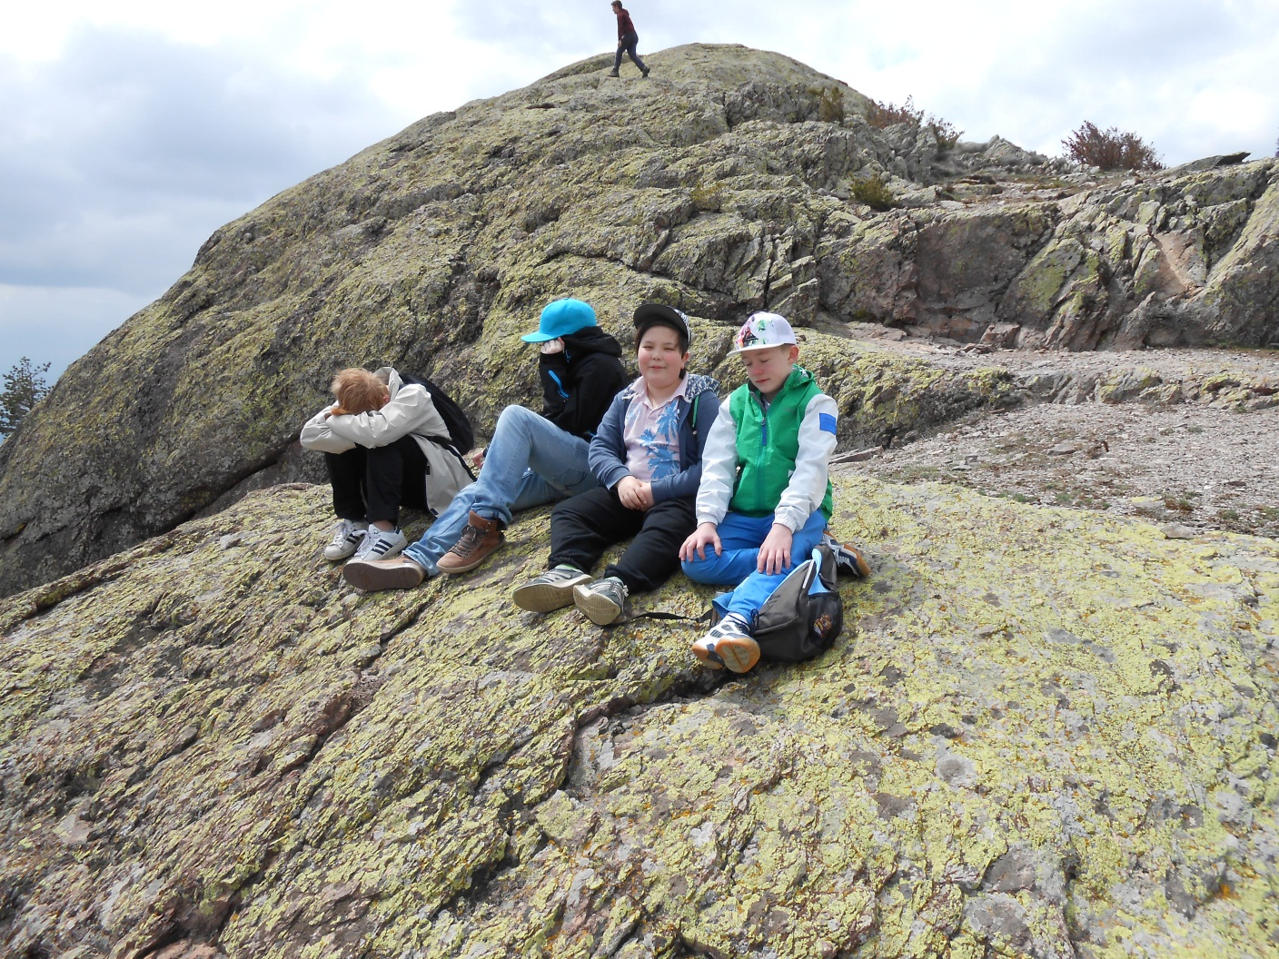
Third meeting-Bulgaria

Slide 13


E-vocabulary
We chose together a set of words which we wanted to learn and recorded them in our native language
By next year we will know lots of new languages!

Slide 14
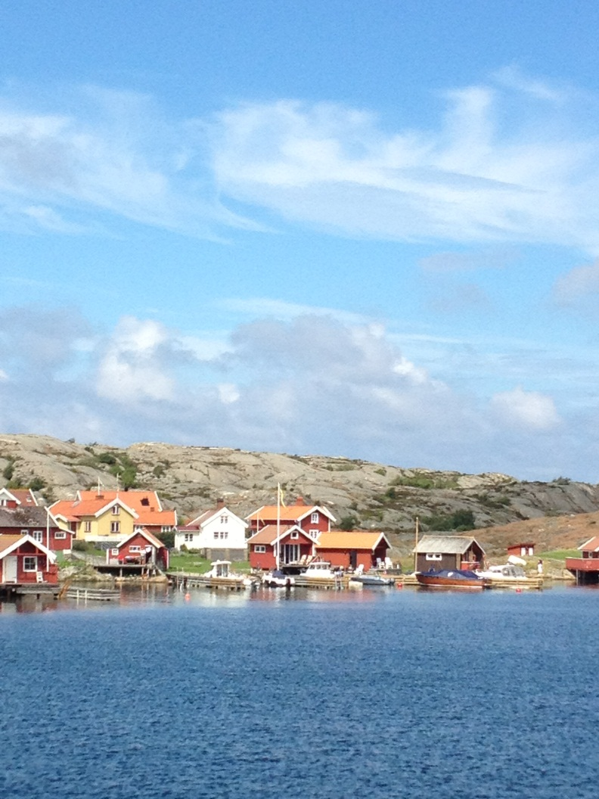
Fourth meeting- Sweden

