Slide 1


Activities done

Slide 2
So far the activities done were the following:
  October 2012: Articles in school magazine;
  October: Power Point Presentation CD for the countries partners;
  Facebook: profile for the partnership;
  November: The common website for the partnership;
  November: Project logo;
  All partner schools encouraged students to draw by hand the project logo. The coordinator collected the points and declared Bulgaria the winner. Bulgaria designed the logo on the computer and sent it to all partners.
 | BUL | LAT | POL | ROM | SWE
BUL | --- | 2 | 4 | 3 | 1
LAT | 4 | --- | 2 | 3 | 1
POL | 4 | 2 | --- | 3 | 1
ROM | 3 | 4 | 2 | --- | 1
SWE | 3 | 2 | 1 | 4 | ---
TOTAL | 14 | 10 | 9 | 13 | 4

Slide 3

Final Project Logo
The winner
Bulgaria

Slide 4
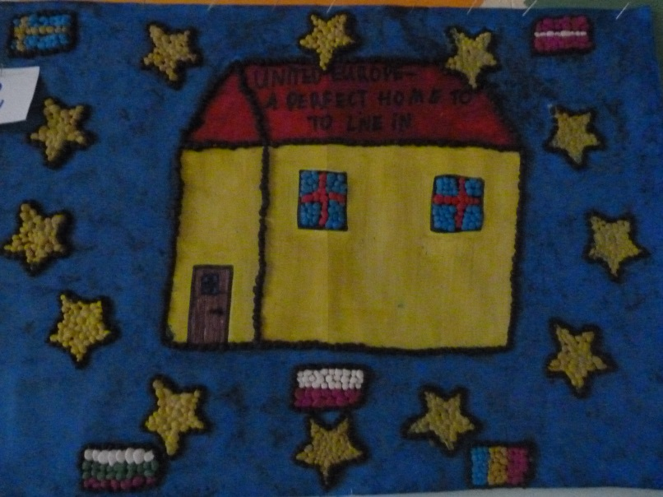
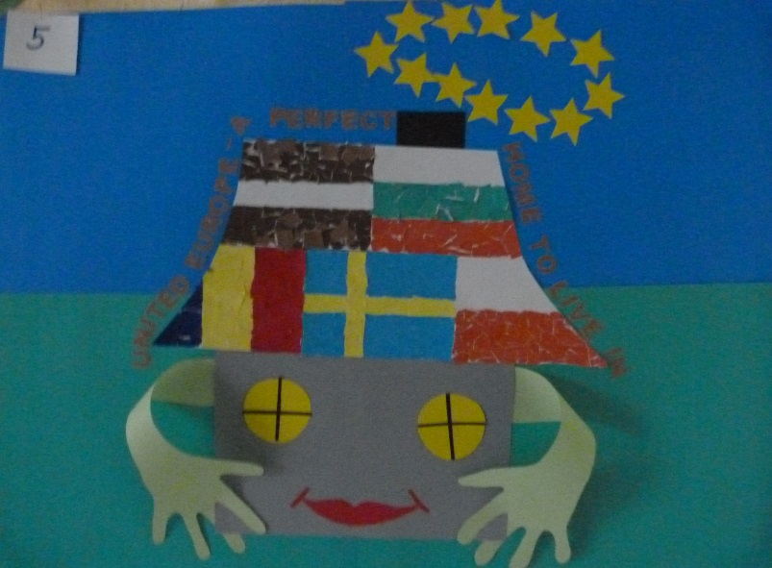
Logos
}
Poland

Slide 5
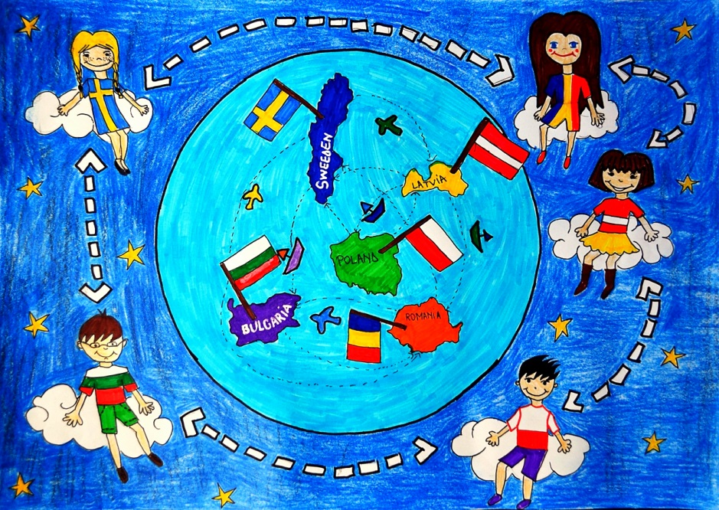
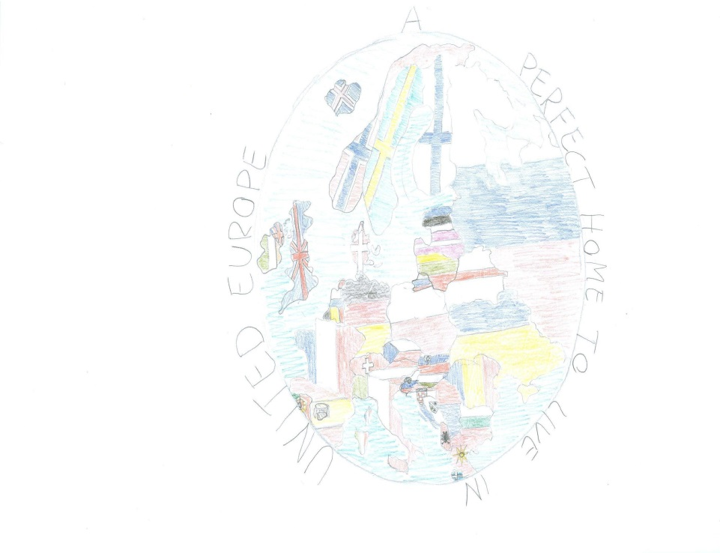
-> Romania
-> Sweden

Slide 6
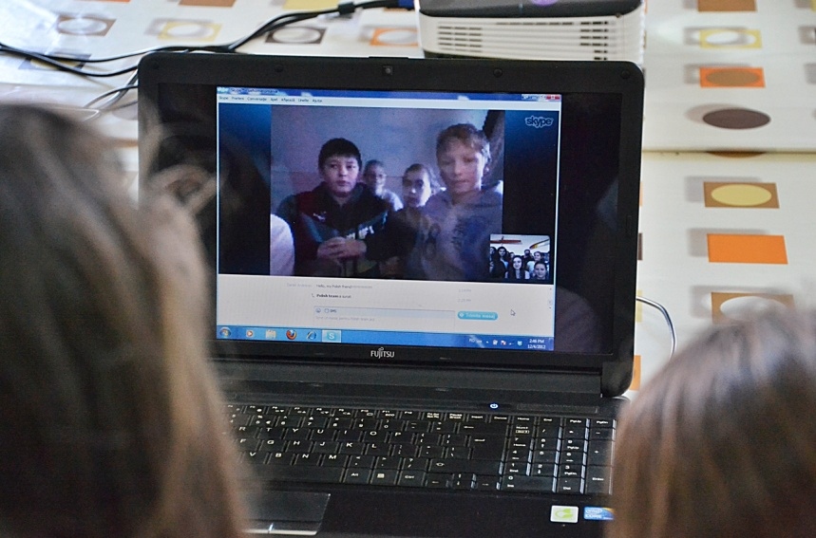
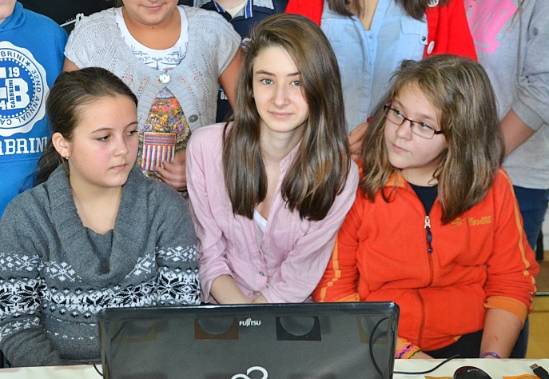
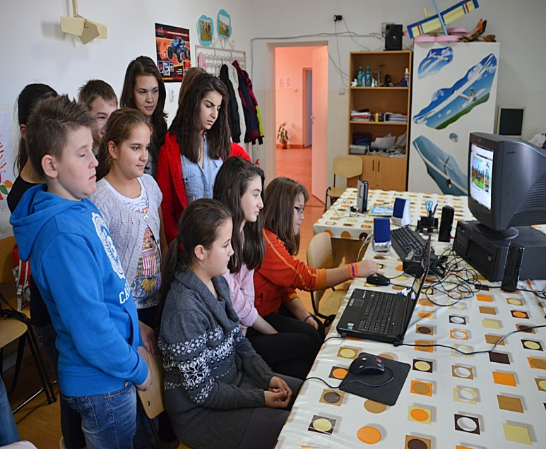
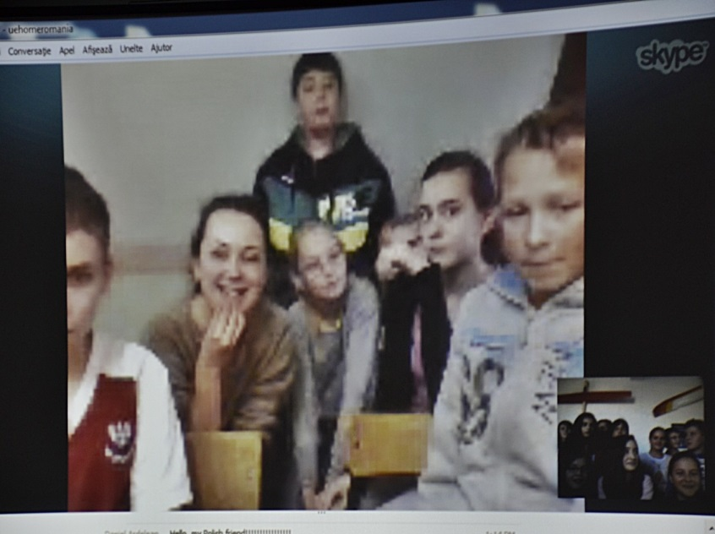
Teleconferences
ROMANIA- POLAND

Slide 7
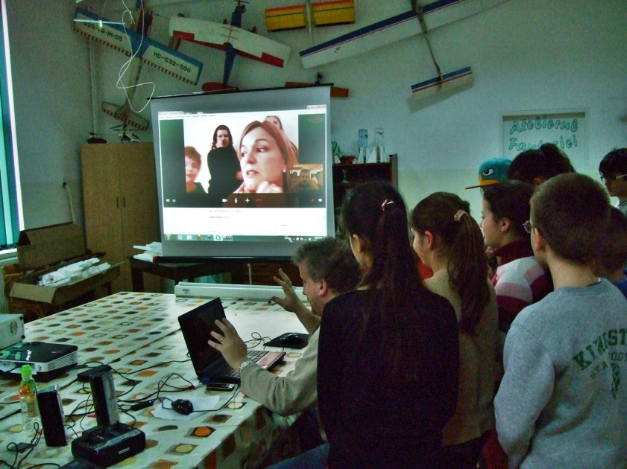
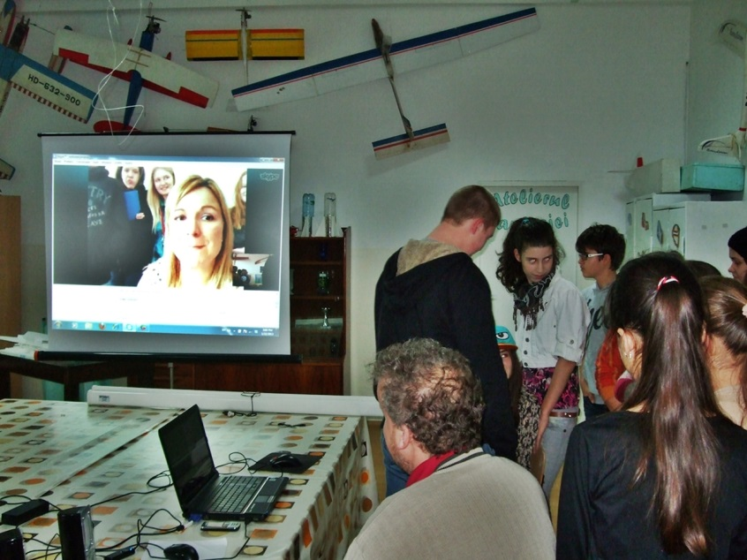
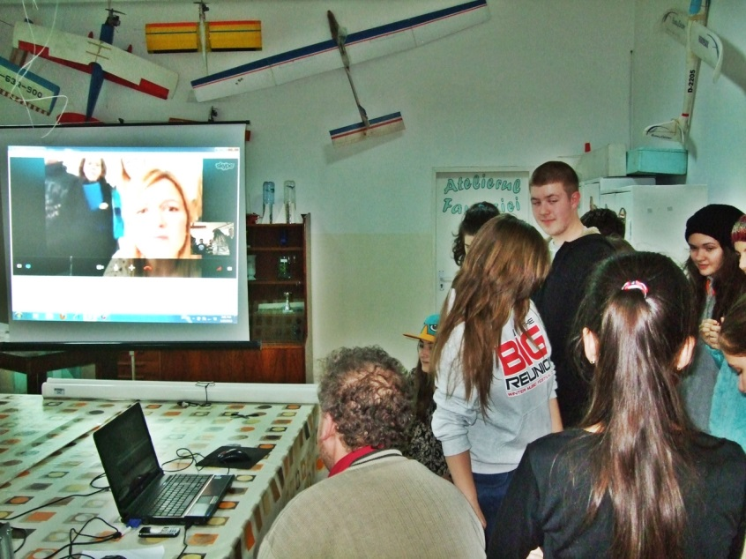
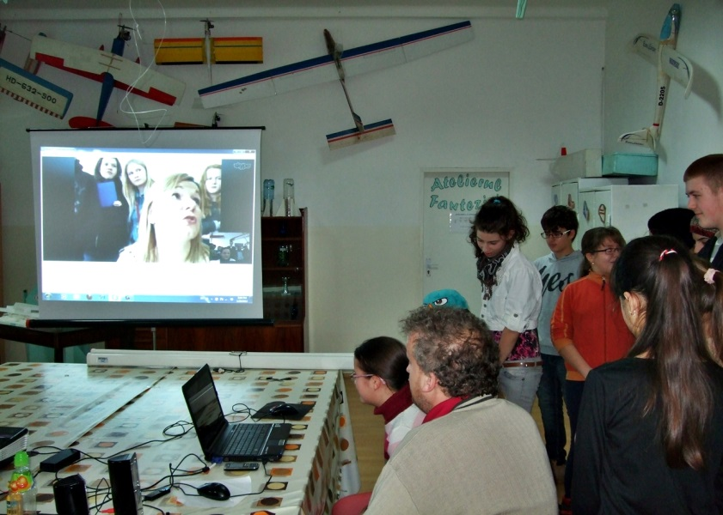
ROMANIA - SWEDEN

Slide 8
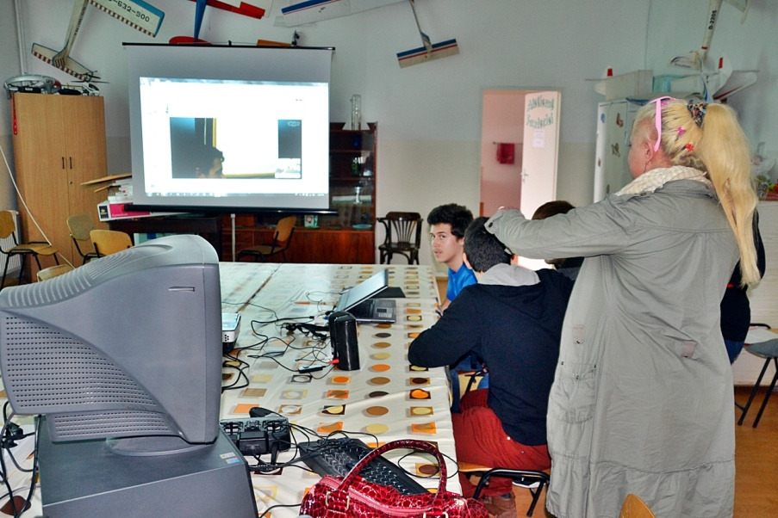
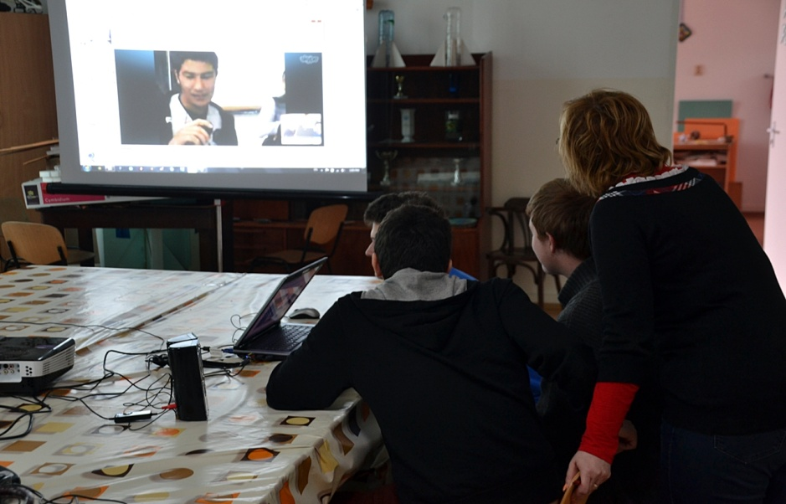
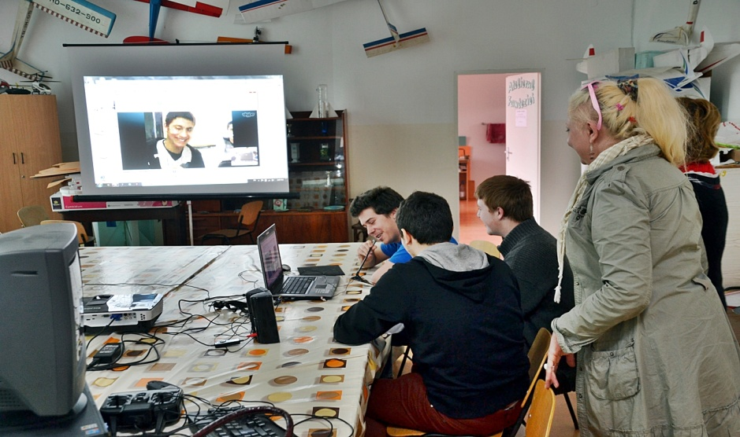
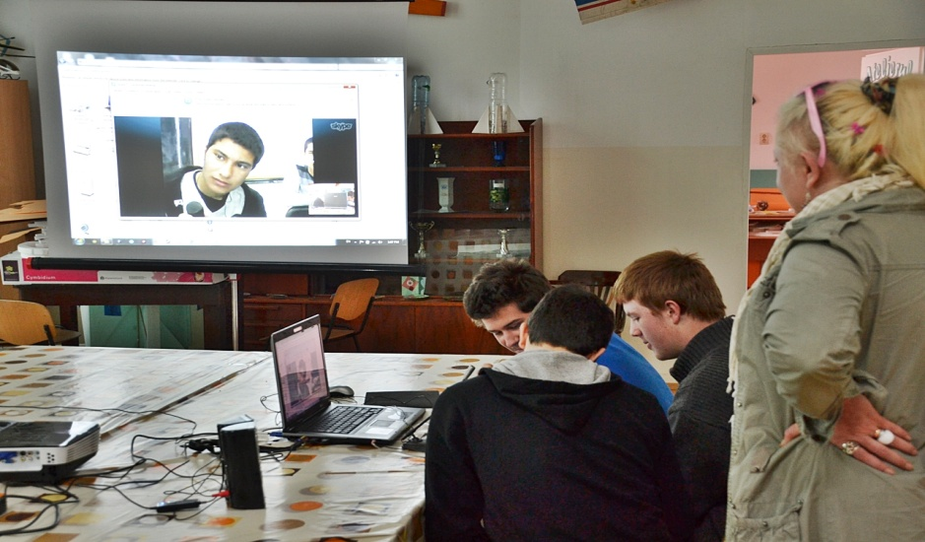
ROMANIA - BULGARIA

Slide 9
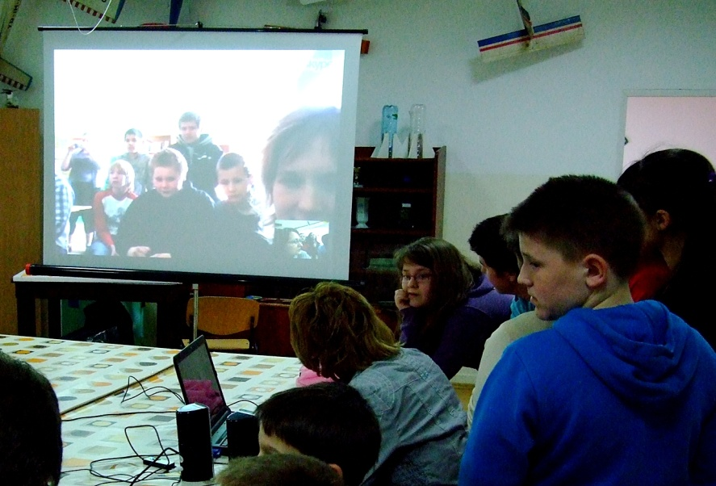
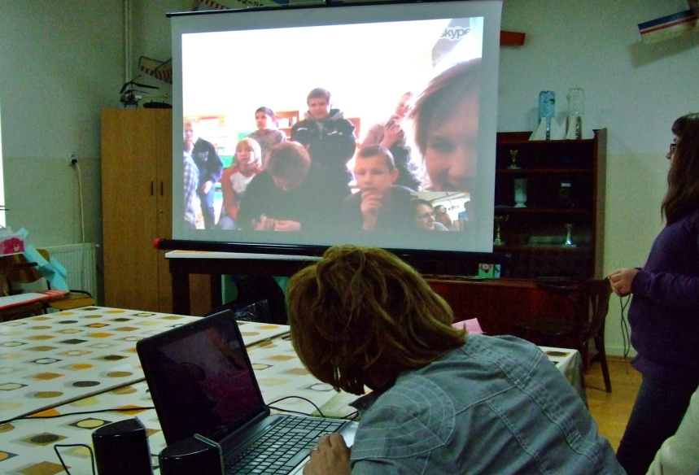
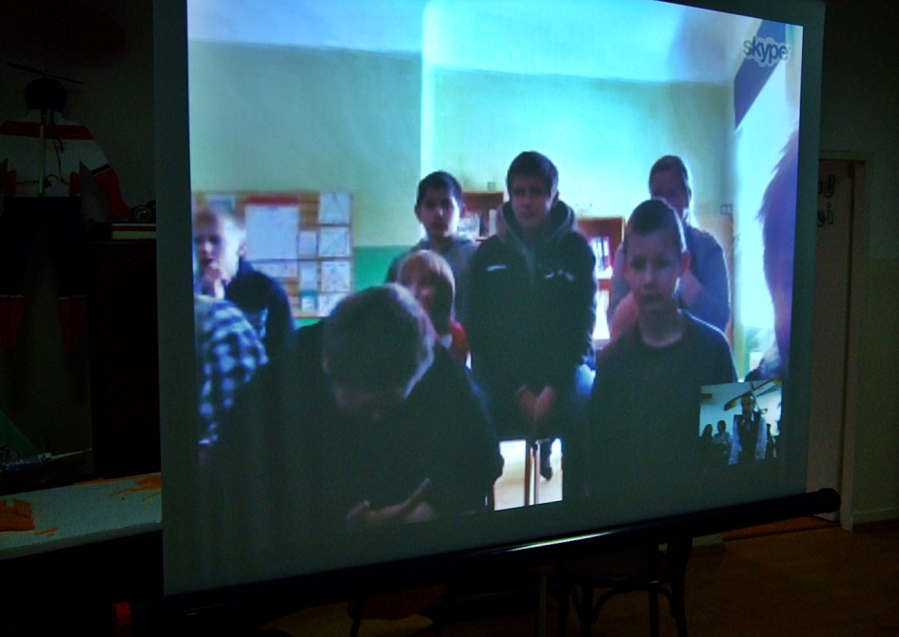
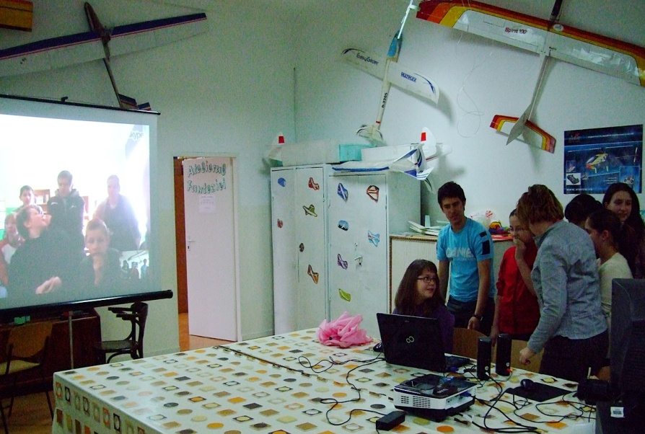
ROMANIA - LATVIA

Slide 10
For getting known each other, students involved in the project took care of the conferences between them. Teleconferences were organised every month by coordinators, as follows:
  December 2012: Romania – Poland
  Sweden – Latvia
  January 2013: Bulgaria – Latvia
  Romania – Sweden
  February 2013: Romania – Bulgaria
  Poland – Latvia
  March 2013: Swden-Bulgaria
  Latvia-Romania
  April 2013: Poland – Sweden
  May 2013: Bulgaria - Poland

Slide 11
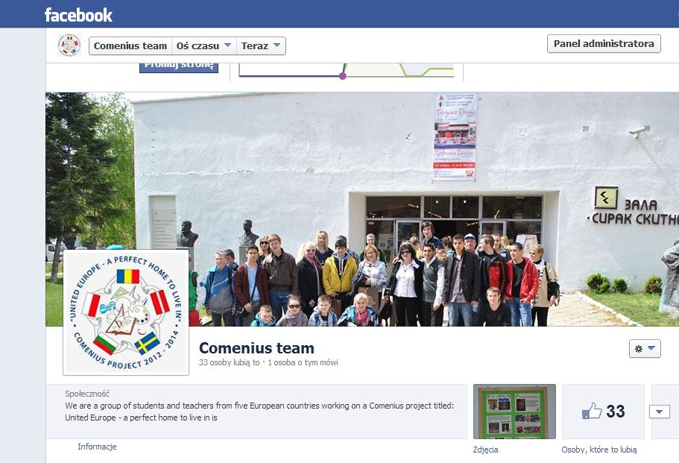
Facebook
The Facebook profile for the partnership.

Slide 12
The Polish partners created the Facebook profile of the project.
Latvian partners created an initial evaluation questionnaire and sent it to all the partners who applied it for all students involved in the project.

Slide 13
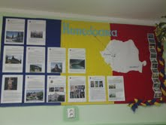
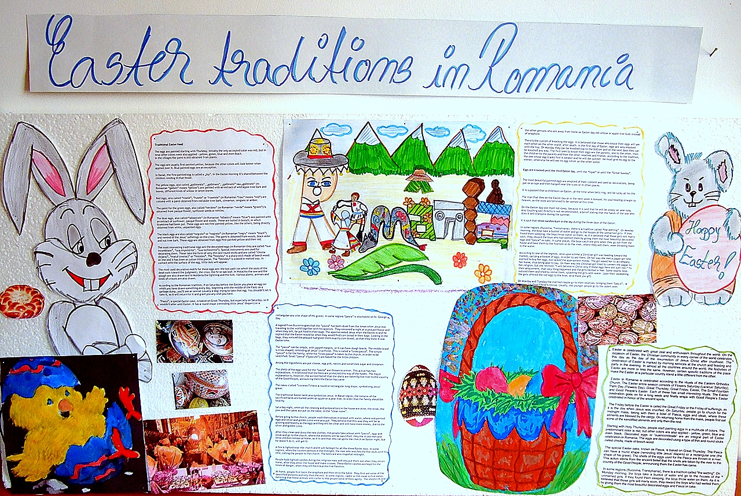
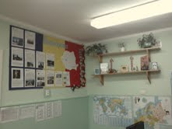
Romanian Posters
Posters about partner countries in our school

Slide 14
Christmas and New Year’s Eve.
Traditional Recipes
Students chose three traditional recipes for Christmas and New Year’s Eve, translated them into Engish, put some pictures, exchanged the recipes and Latvian partners collected them in a cooking leaflet. Every partner cooked one recipe from the partnership. We received the cooking leaflet in the meeting in Latvia.

Slide 15
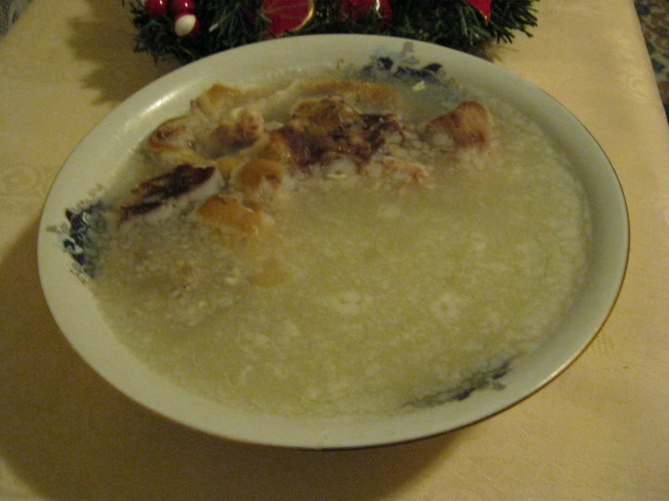
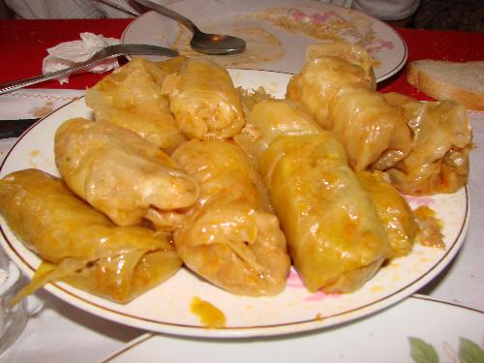
Piftie (Pork Aspic)
Sarmale (Meatballs covered in cabbage)

Slide 16
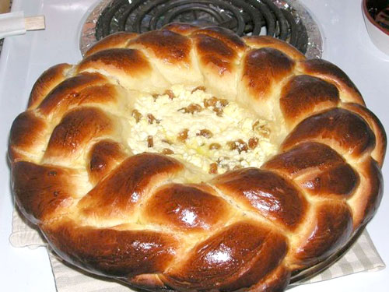
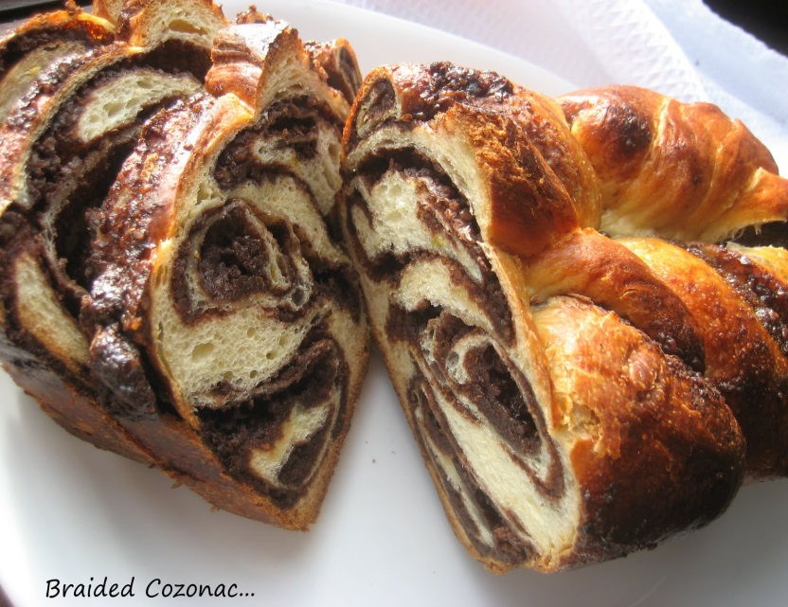
Pască (Moldavian cheese cake)
Cozonac (Buns)

Slide 17
Informative brochure
Swedish partner collected all information and created an informative brochure for dissemination the project (between September 2012 – January 2013) and presented it at the meeting in Latvia.

Slide 18
Language e-vocabulary
Every partner collected 30 words and sent it to Swedish school. Swedish partner collected all and sent it to all partners to translate in their own language and recorded with the students. They will collect all on a DVD at the meeting in Bulgaria. The students enjoyed this activity a lot.

Slide 19
Concrete objectives of the project
- To help our students introduce themselves in a foreign language;
- To compare traditions for special holidays (Easter, Christmas)
- To identify traditional food in each partner’s country and to develop a recipes book;
- To know other educational systems;
- To get in touch with other cultures;
- To improve the use of multimedia skills;
- To realise a common magazine with articles written by students from all partner schools;

Slide 20
Reports and reflections
Both students and teachers involved in the project wrote reports and reflections from the work meetings (June 2013);

Slide 21
Description of mobilities and other activities
The first meeting: Romania, October 2012, during this project meeting the schedule of project activities for the first year has been done.
The second project meeting: Latvia, February 2013, during which problems and dificulties in solving project topics were discussed.
The third project meeting: Bulgaria, April 2013, during which we ”get acquainted” with all the partner’s educational system.
The fourth project meeting: Sweden, June 2013, evaluation of first year of project.

Slide 22
Partner schools prepared DVDs with the activities had been done during the first year( May 2013).
Every partner school organised Comenius Gala in June 2013.

Slide 23
Thank you for your attention!

