Slide 1
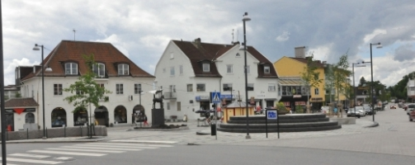
Kinna, Marks Kommun, SWEDEN

Slide 2
Mark Municipality is located in the southern part of Västergötland and is part of the county Västra Götaland. Mark has 33 758 inhabitants (30 November 2012). There are a number of small and medium-sized towns, the largest of which is Kinna. In Kinna approximately 7,700 people live. The main industry itextile companies, which made themselves known over the world , and in addition several furniture factories. There are also companies in the chemicals, electronics and packaging industries.

Slide 3
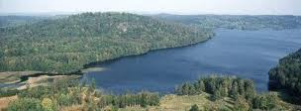
Kinna is also known for: its beautiful nature

Slide 4
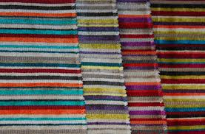
Textiles

Slide 5
and for basketball!

