Slide 1
Valentine's day
14th February

Slide 2

History of Valentine's day
February has long been a month of romance.It is associated with Valentine’s day celebration.
The origin of this lovers day goes back as early as 270 A.D and started with the clash between a kindly priest and a mighty ruler.

Slide 3

What is Valentine's day?
Valentine’s day is celebrated every year on 14 th February and is not only a holiday but it is also a day where people show feelings of love, affection and friendship.
Valentine’s day is the perfect time where you can express your feelings to someone.

Slide 4
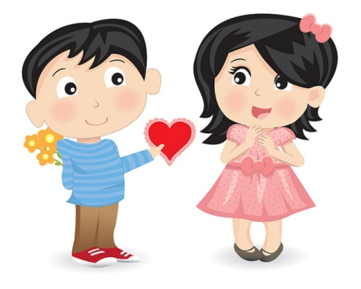
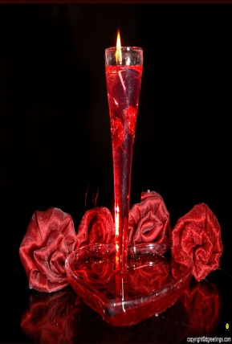
What do people do?
Many people give greeting cards, chocolates, jewerly or flowers, particularly roses, to their partners or admirers on Valentine’s day.
Some people take their loved ones for a romantic dinner at a restaurant while others may choose this day to propose or get married.

Slide 5

Something different for
Valentine's day
Valentine’s day in Finland refers to “Friend’s day”(“Ystävän päivä”), which is more about remembering all friends rather than focusing solely on romance.

Slide 6
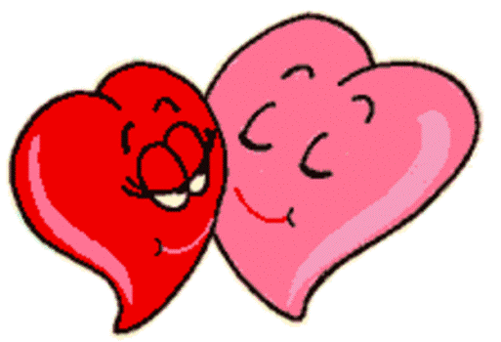
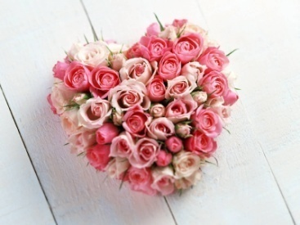
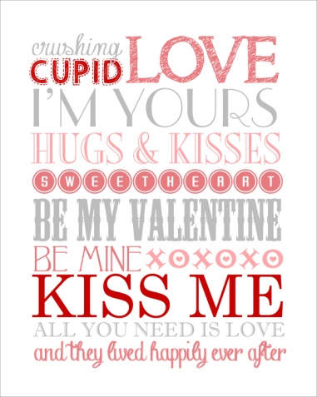
Symbols
Hearts,the color red and pink;
Roses;
Images and statues of cupids (cupids’ bowes and arrowssymbolize the feeling of romance and love on Valentine’s day).

Slide 7

Little Cupid
Cupid is usually portrayd as a small winged figure with a bow and arrow .In mythology ,he uses his arrow to strike the hearts of people. People who fall in love are sometimes said to be “struck by Cupid’s arrow”. The day focuses on love,romance, appreciation and friendship.

Slide 8
Background
The origin of Valentine’s day are not clear, but many sources believe that it stems from the story of St Valentin, a Roman priest who was martyred on or around February 14 in the year 270 CE. How he became the patron saint of lovers remains a mystery but one theory is that the church used the day of St Valentine’s martyrdom to Christianize the old Roman Lupercalia, a pagan festival held around the middle of February.

Slide 9
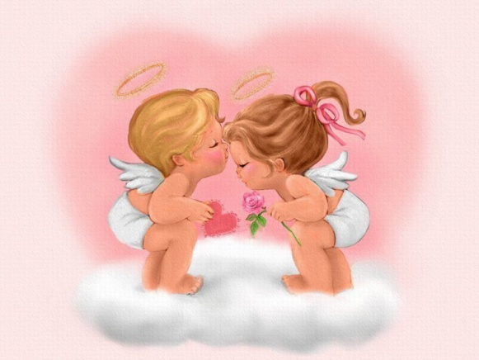
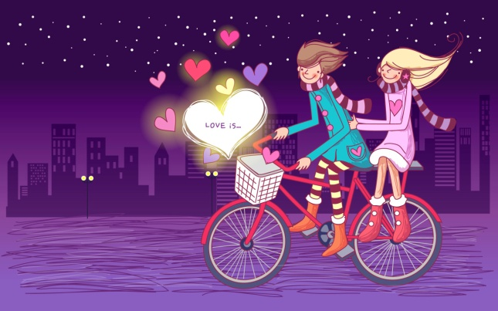
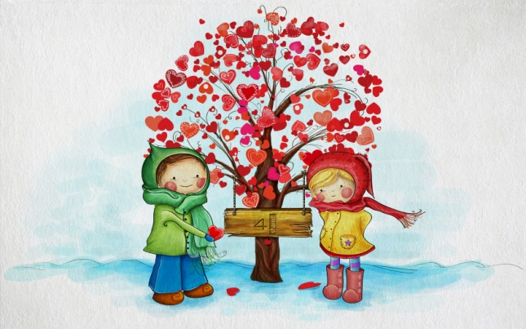

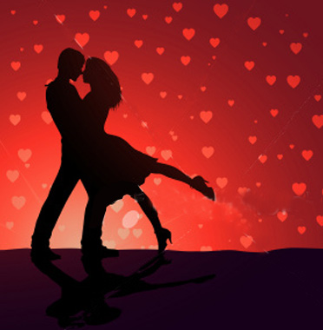
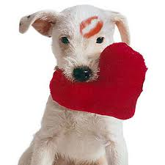

Slide 10


