Slide 1
Varpen
Training school
Träningsskola

Slide 2
The school
“Varpen” is a division of basic special schools which study according to the training school curriculum. The students do not study ordinary subjects but train basic skills such as: daily activities, motor skills, communication, perception of reality and artistic activities. The students all have a low level of developement often in combination with multiple disabilities.

Slide 3
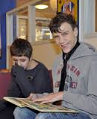

Slide 4
The staff
The staff consists of three teachers who are trained in special education focusing on disabilities. In addition, there is usually a student assistant assigned to each individual student.

Slide 5
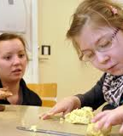

Slide 6
The students
This school year 10 students attend “Varpen”. They are divided into two classes. Several of the students have individual teaching all day or part of the day.

