Slide 1
United Europe
-a perfect home to live in
RECYCLING SESSION
SWEDEN

Slide 2
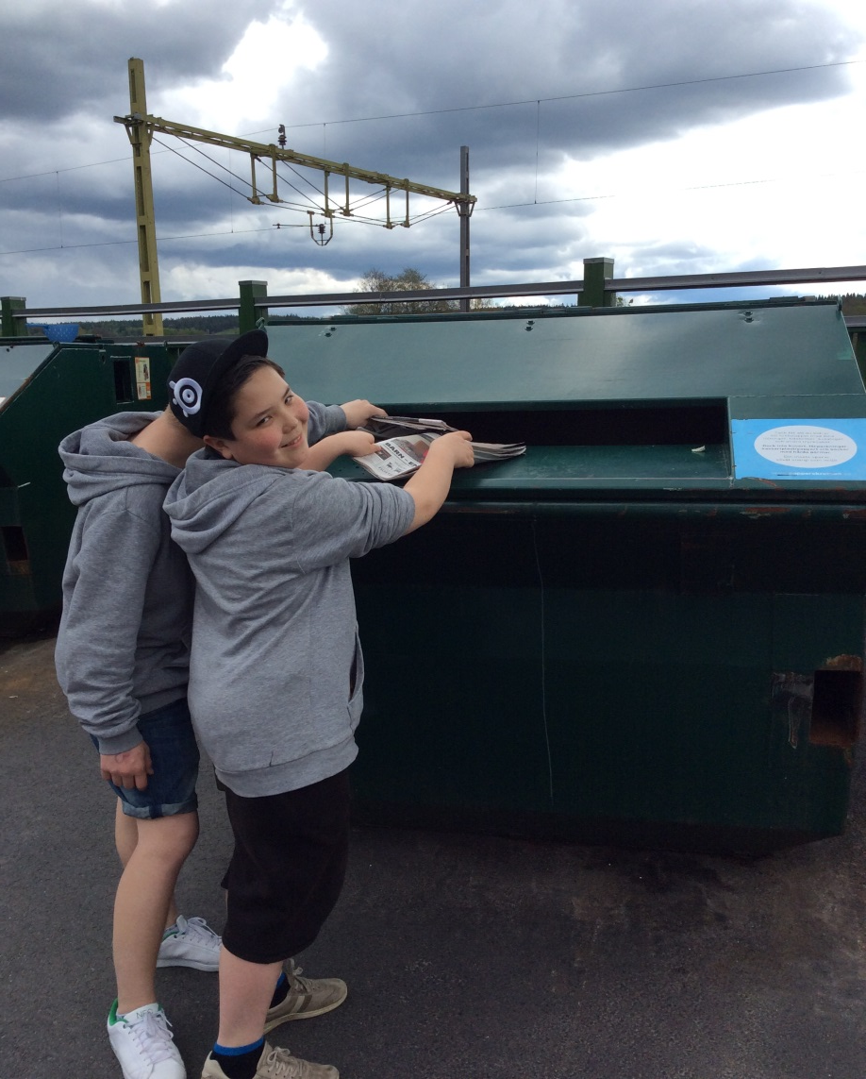
We collected thrash in school and went to the recycling station

Slide 3
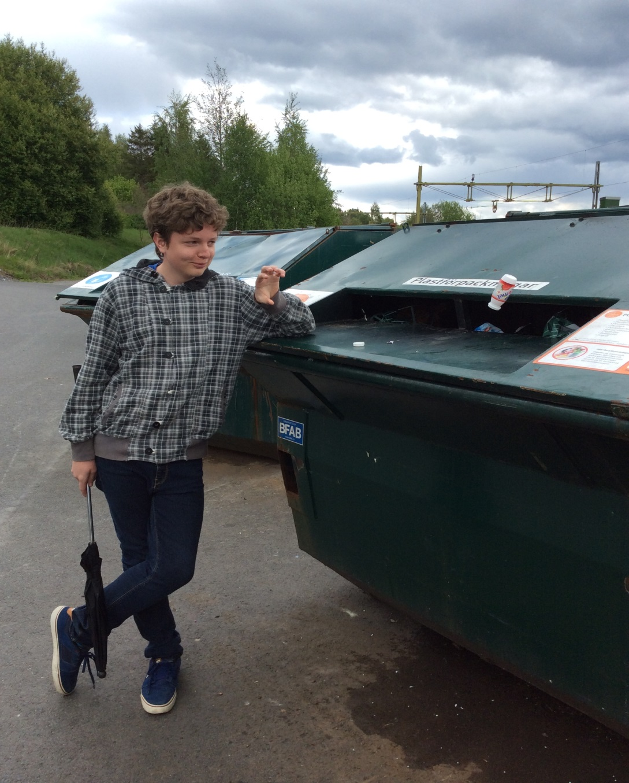
Plastic

Slide 4
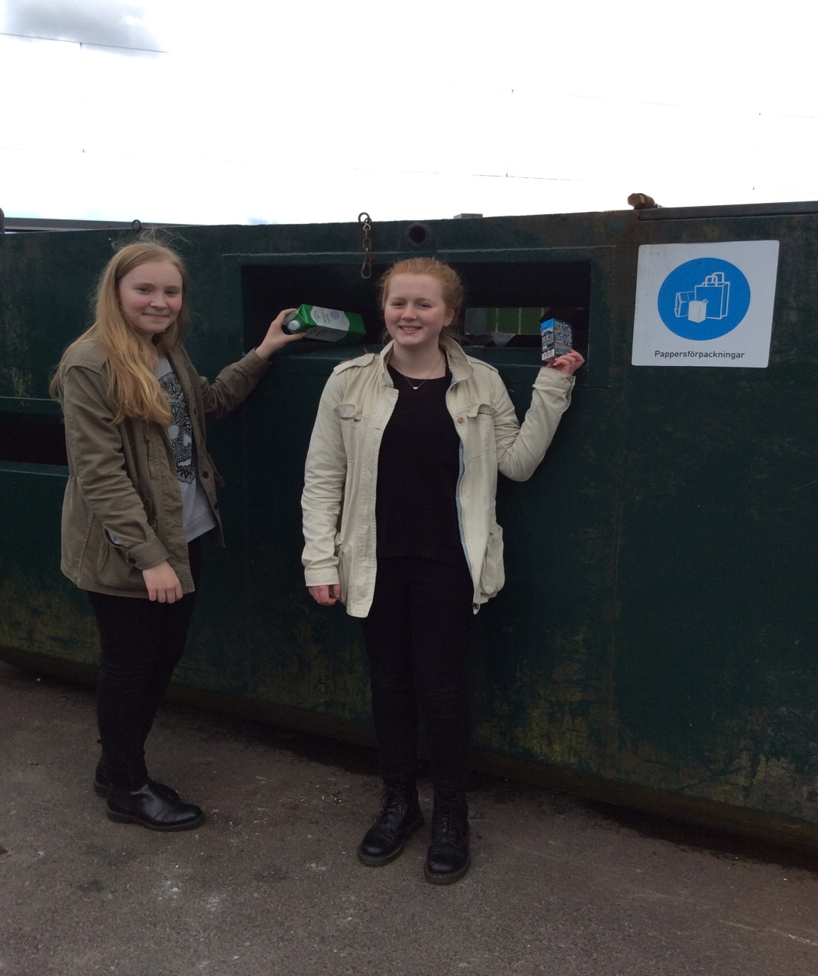
Carton

Slide 5
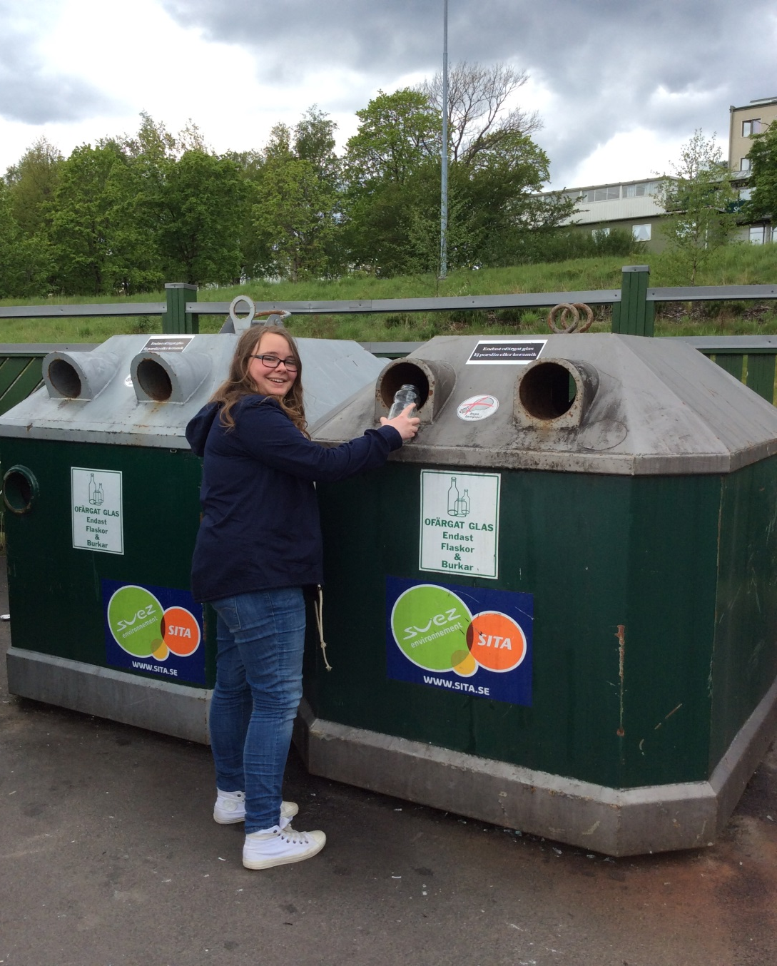
Glass

Slide 6
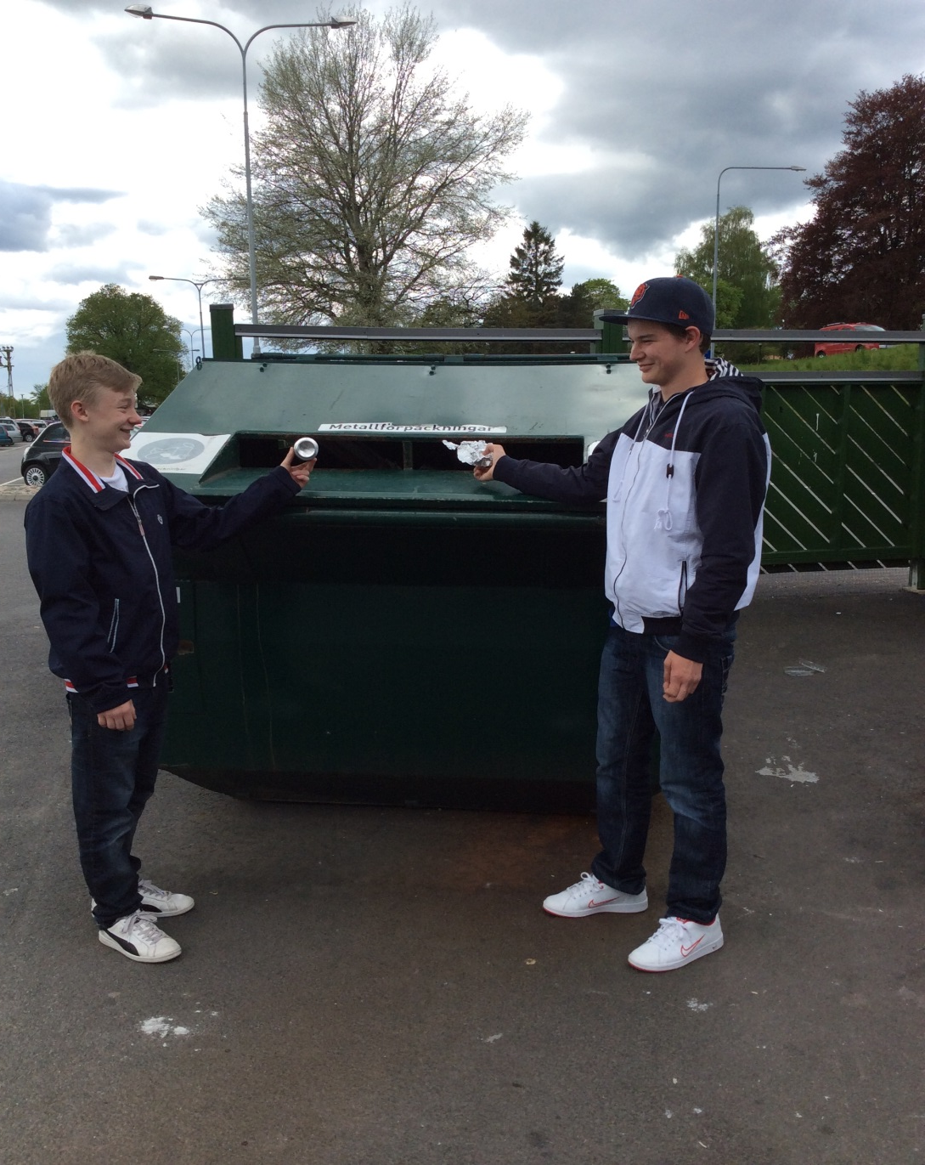
Metal

Slide 7
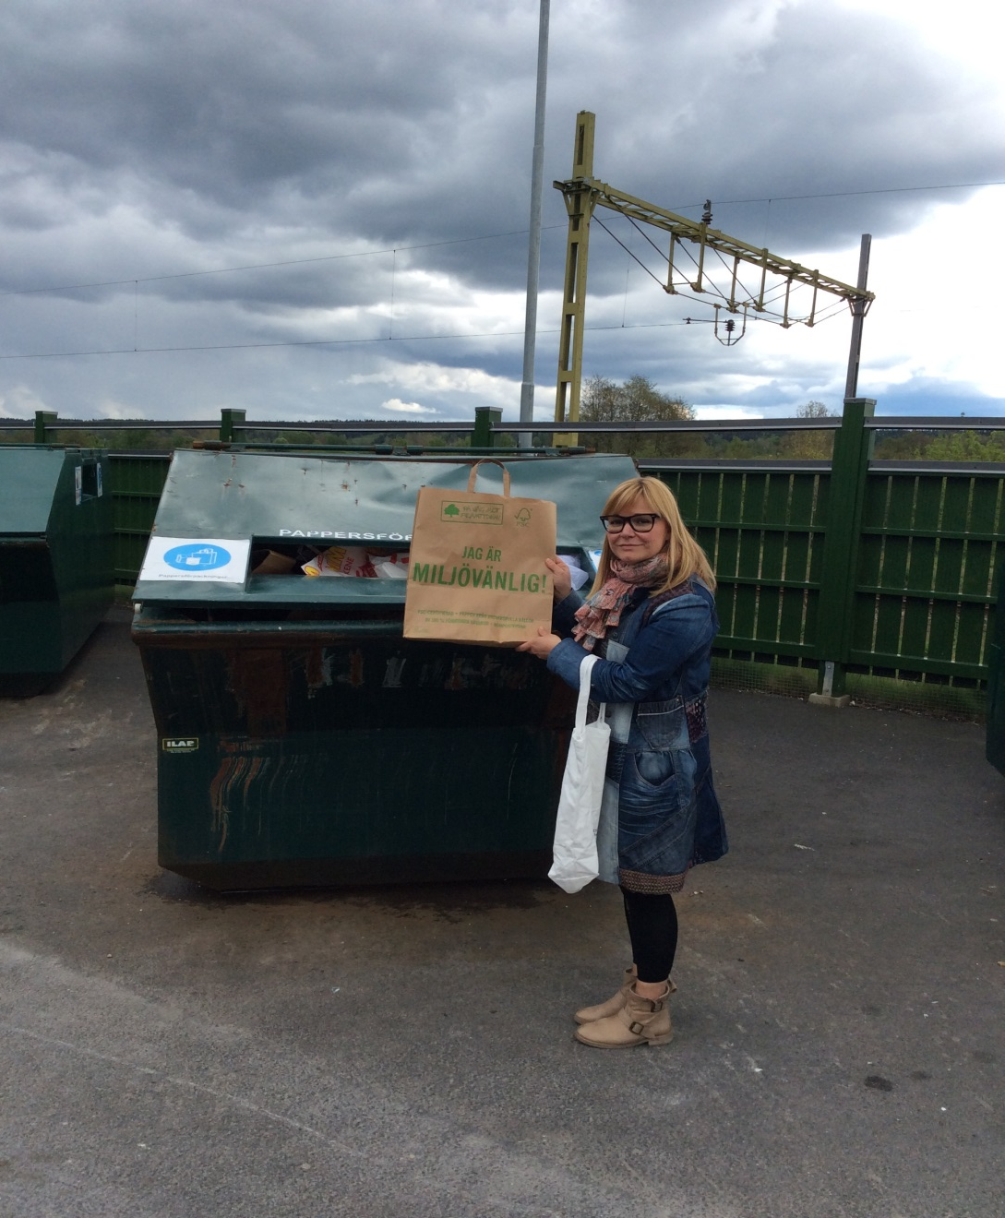
Paper

Slide 8
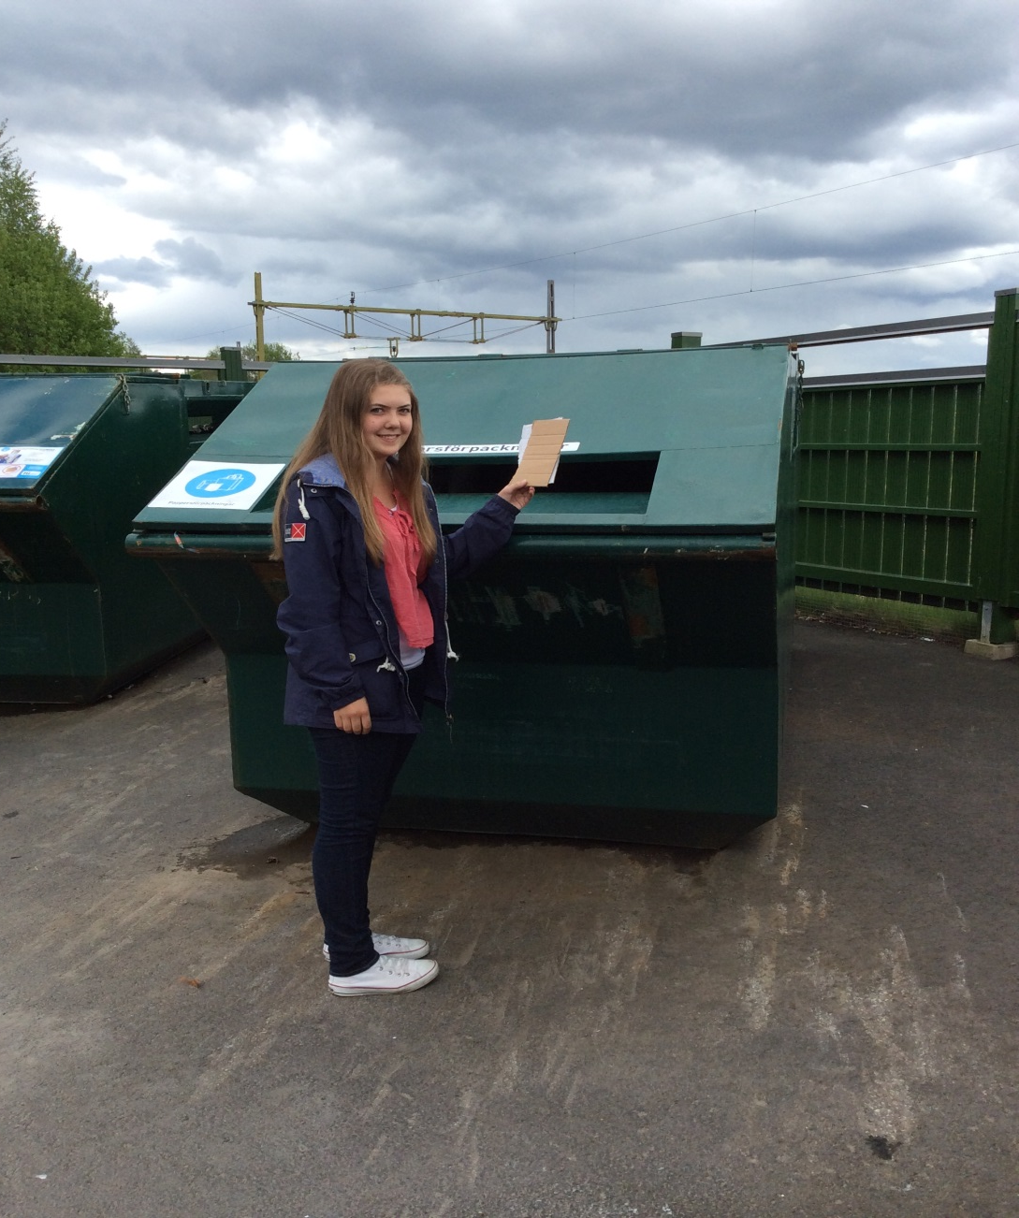
Cardboard

Slide 9
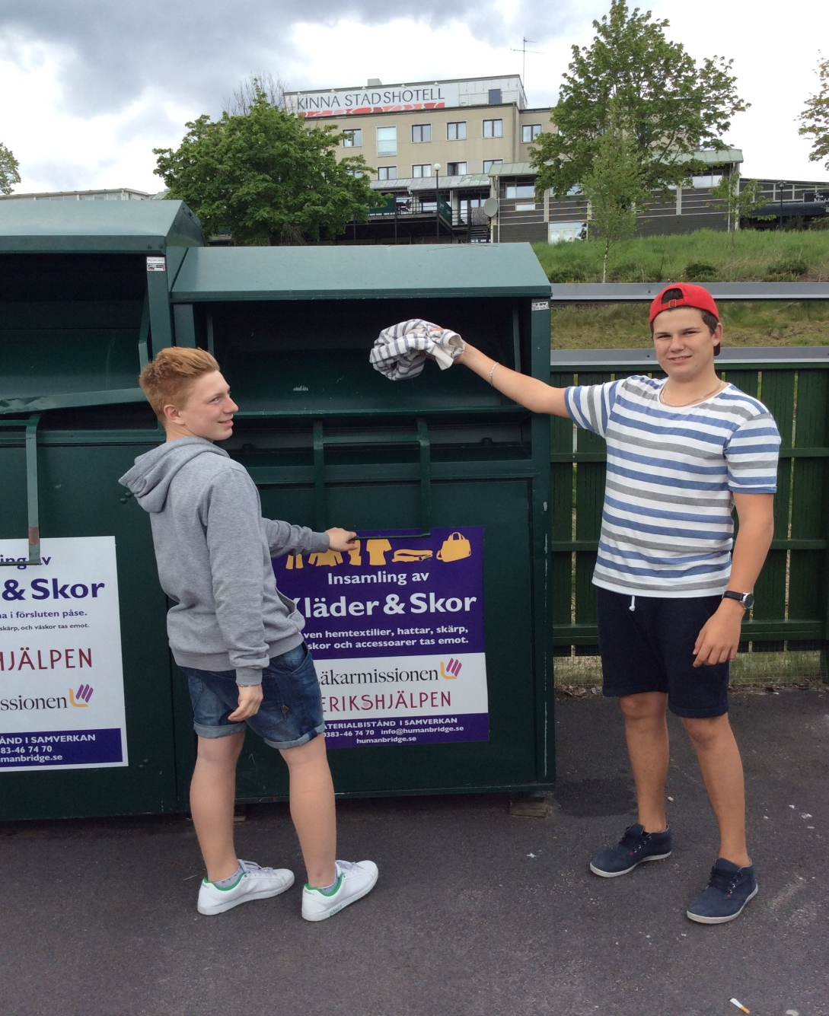
Clothes

Slide 10
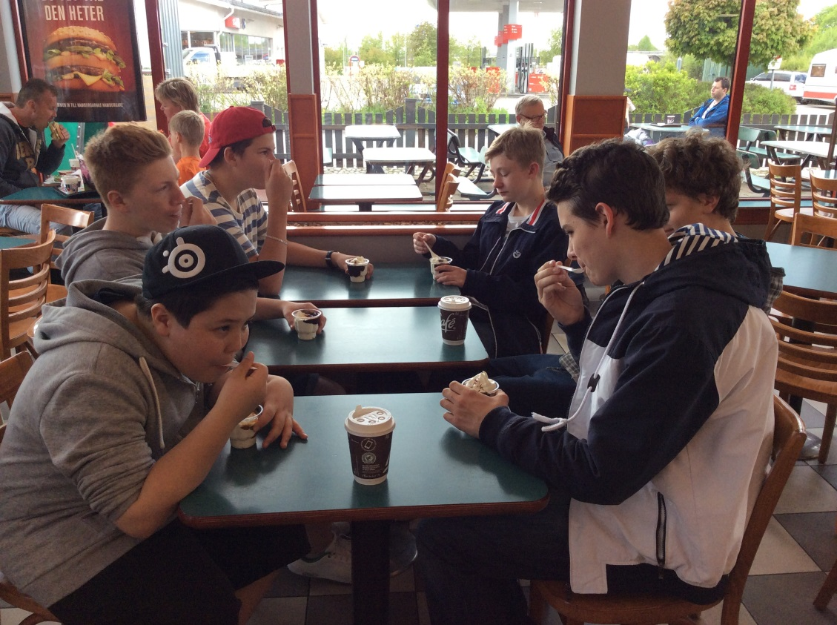
Afterwards we went to McDonald’s

Slide 11
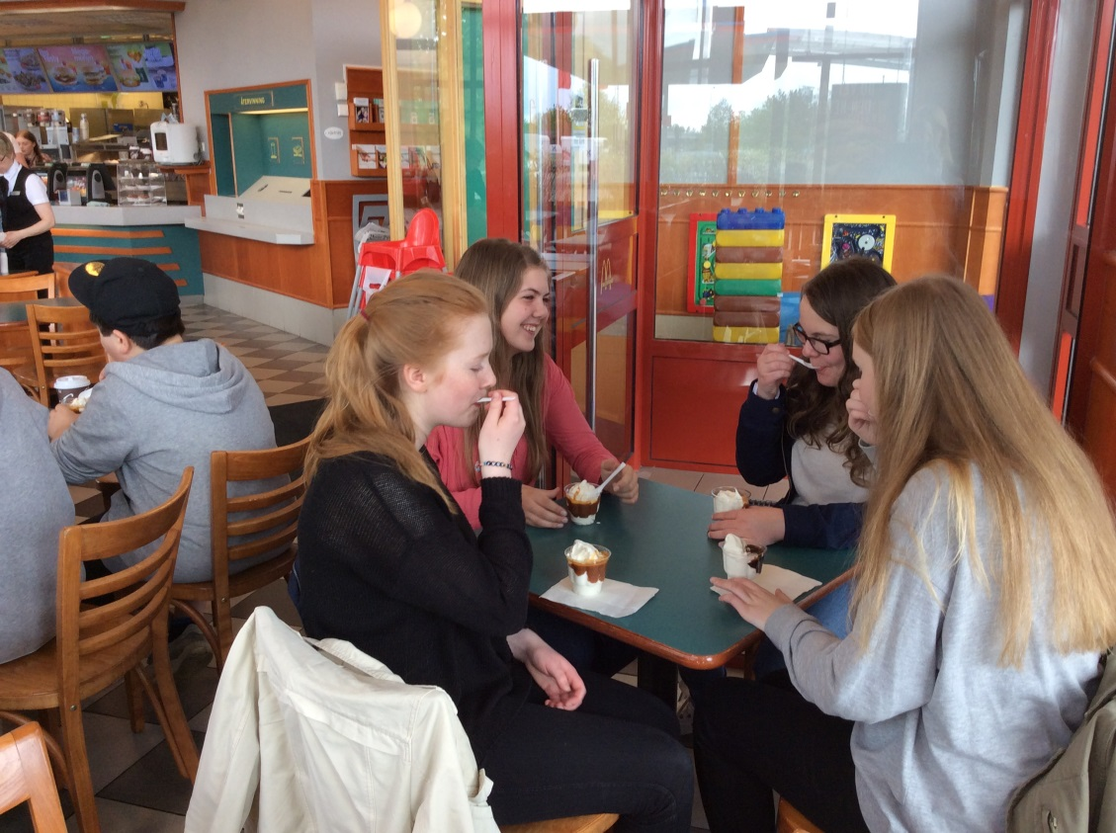
for icecream

Slide 12
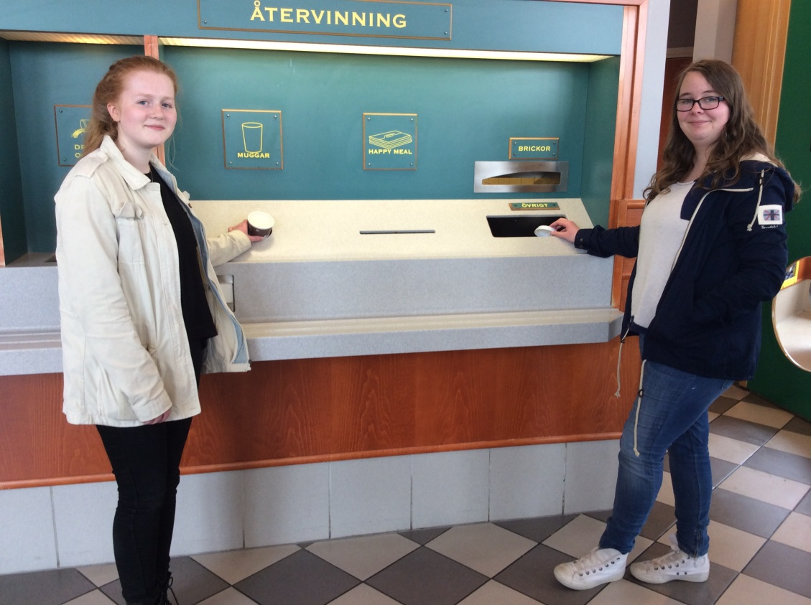
and some more recycling!

