Slide 1
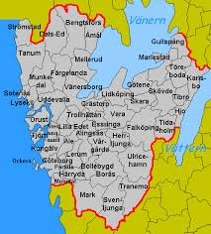
Welcome to….

Slide 2
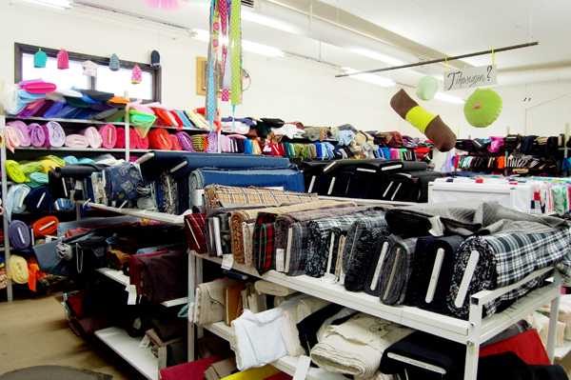
Sjuhäradsbygden and a textile heritage

Slide 3
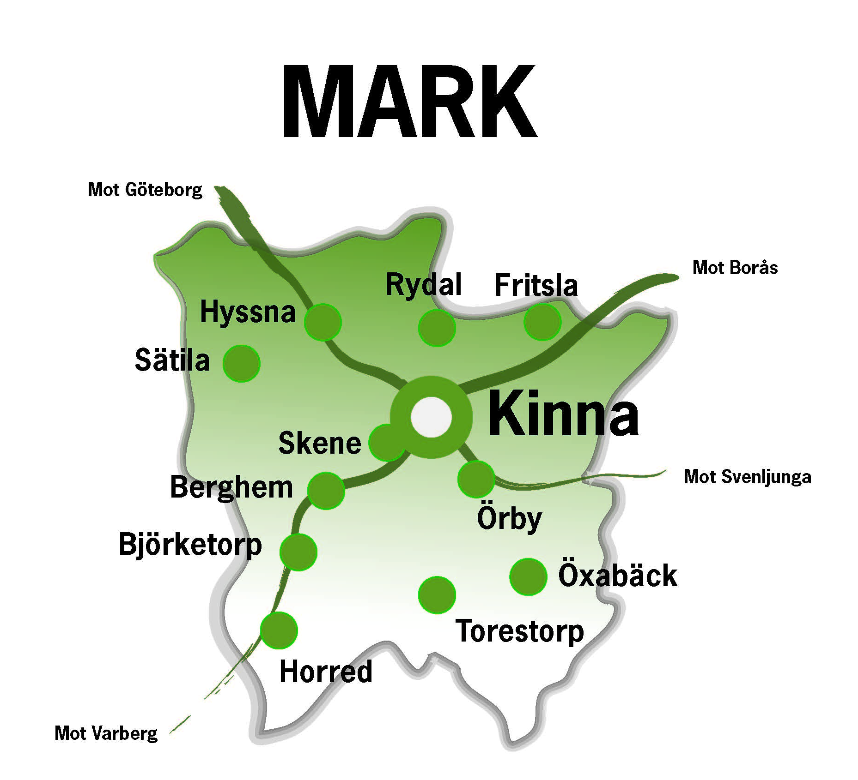
This is
We are 33 718 inhabitants in approximately 14 000 households

Slide 4
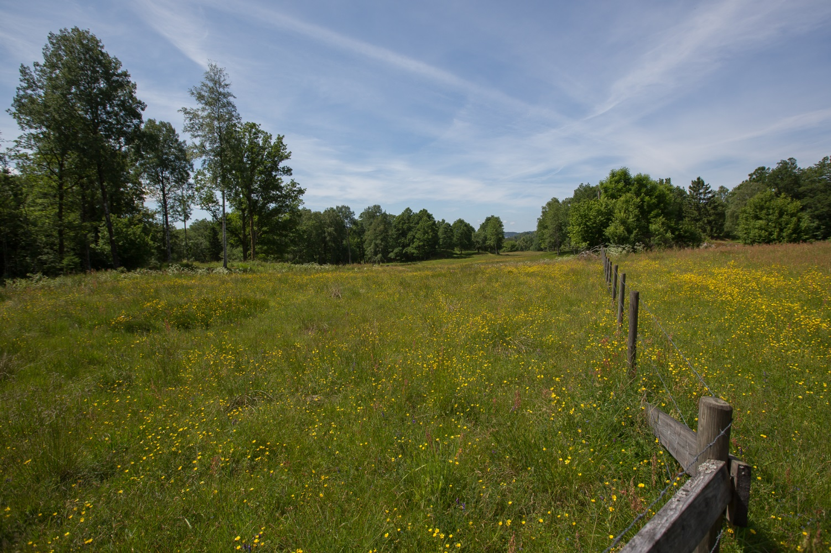
Mark means border
It was once the border between Sweden and Denmark
Important battles were fought here
Notes:
Viskan och Ätran var ”motorvägarna” in i Sverige fram till 1600-talet. Därför drabbade arméerna samman i våra trakter.

Slide 5
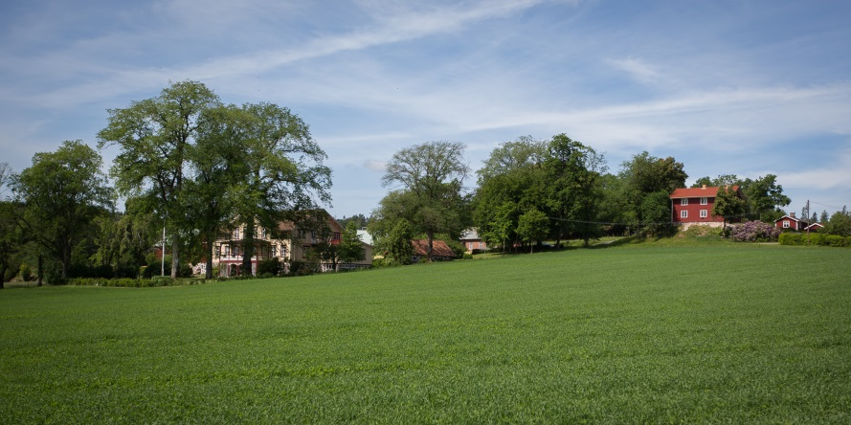
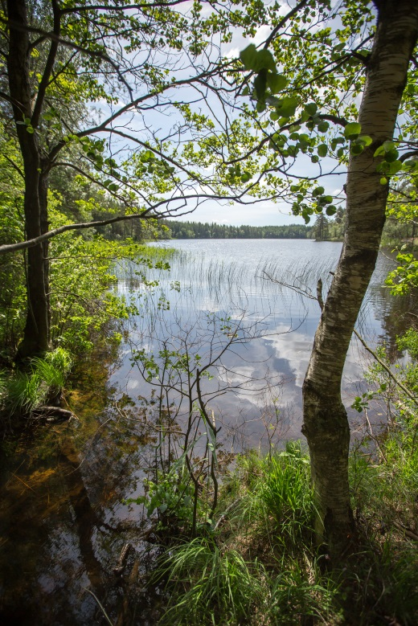
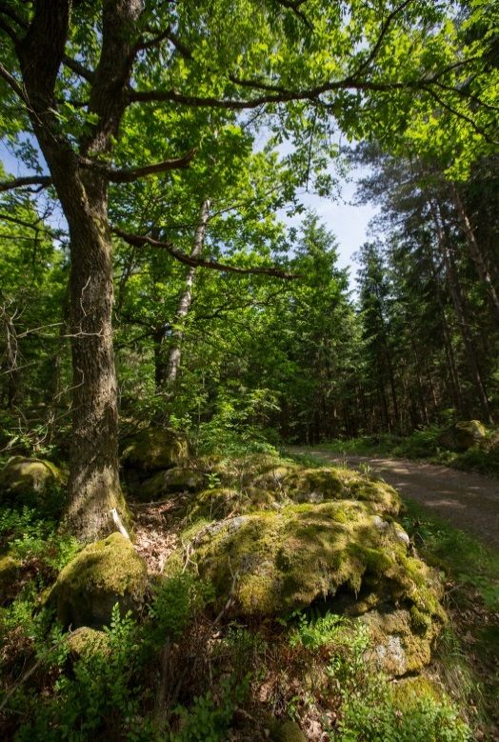
Mark is villages, open landscape, lakes and forests

Slide 6
The shield symbolizes our history and our commercial and industrial life
Wheat
Obvious symbol of our agricultural heritage
Canon balls
Symbolize the battles between Denamrk and Sweden
Shuttle
Symbolizes the textile industry that has made Mark world known
Notes:
Kommunvapnet antogs 1974 men häradssigillet med kulorna är känt från 1500-talet. Skytteln användes av Kinna köping från 1935.

Slide 7
World famous businesses of interior design and smart textiles
Kasthall
Almedahls
Ludvig Svensson
Marks Pelle Vävare
Horreds möbler
Albin i Hyssna
Smart textiles have become incresingly important recently with e.g. TST Sweden, Industritextil Job och Svenska textilfilter, all international brands.
Notes:
Största företagen är emellertid två assistansföretag. De har båda gått om Ludvig Svensson m.fl. de senaste två åren.

Slide 8
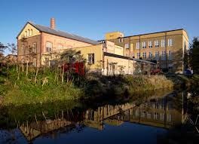
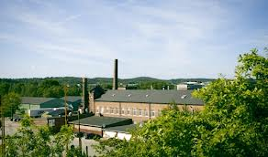

Slide 9
We are 33 718 inhabitants in approx 14 000 households
Age | Number | Mark% | Swe%
0-6 | 2 751 | 8,1 | 8,1
7-18 | 5 175 | 15,3 | 13,9
19-64 | 19 171 | 56,7 | 59,9
65- | 6 724 | 19,9 | 18,1
Källa: SCB, Befolkningsstatistik 2012-12-31

Slide 10
Marks Gymnasieskola

Slide 11
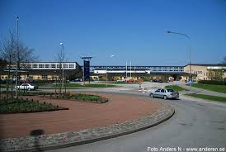
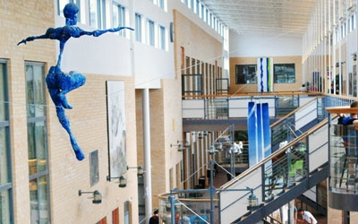

Slide 12
Marks Gymnasieskola is a public upper secondary school, approx 1000 pupils, 100 staff 11 national educational programs 23 orientations 5 theoretical ones 6 vocational ones apprenticeship special needs

Slide 13
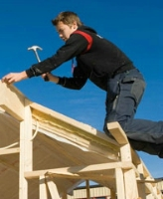
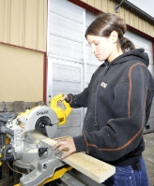
Building and construction is a vocational program with focus on house building, with specializing in wood, concrete or masonry.

Slide 14
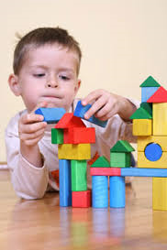
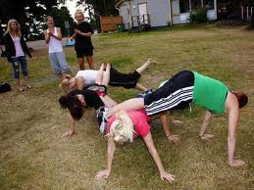
Child and recreation is a vocational program, preparing for work with children, youths or adults in childcare , school or healthcare.

Slide 15
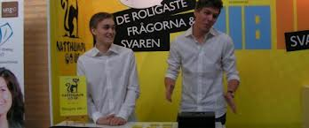
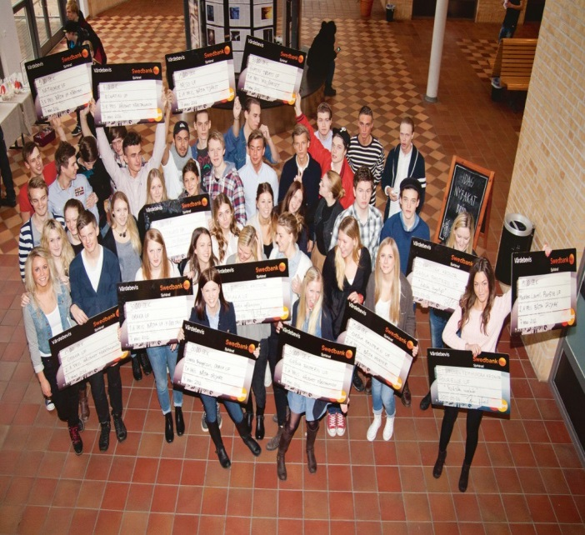
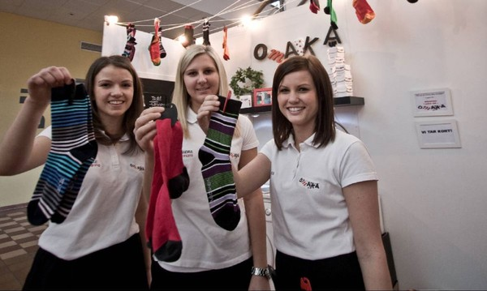
Business management and economics is praparatory for higher education with focus on entrepreneurship, law and business.

Slide 16
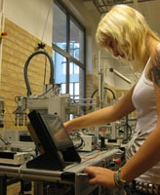
Electricity and energy is a vocational program preparing for work in automation or electrical engineering.

Slide 17
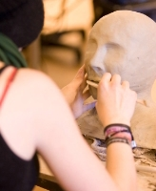
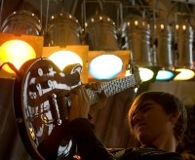
Arts is preparatory for higher education with two orientations, esthetics and media, and music.

Slide 18
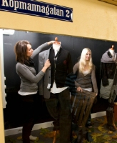
Business and administration, is a vocational program focusing on trade and service, including working as a salesperson in a shop or online.

Slide 19
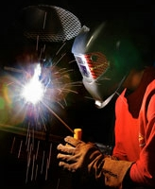
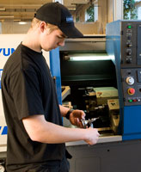
Industrial technology is a vocational program with two orientations, production and welding.

Slide 20
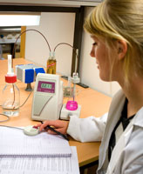
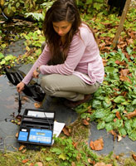
Natural science is preparatory for higher education specializing in biology, chemistry, physics and mathematics.

Slide 21
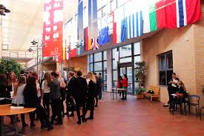
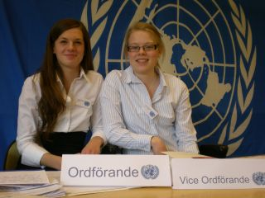
Social science is preparatory for higher education with two orientations, behavioural science and social science.

Slide 22
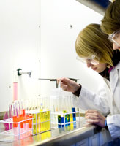
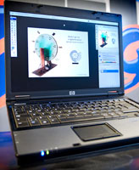
Technology is preparatory for higher education with two orientations, design and product development, and production technology.

Slide 23
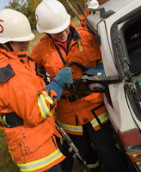
Health and social care is a vocational program preparing for work in healthcare and social care.

Slide 24
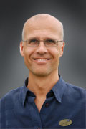
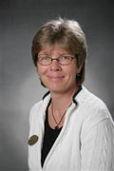
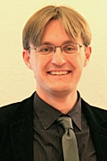
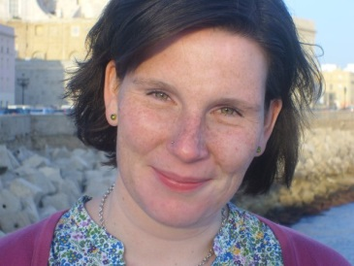
Principals and administration
Väst
Inka
Horstmann
Industri Natur Teknik
El
Bygg
Öst
Lars Gunnar Johansson
Ekonomi Handel Samhäll
Barn- o fritid
Syd
Inger Strömberg
Estet Vård- omsorg Gymnasiesär
Idrottsgymn.
Nord
Claes-Håkan Martinsson
Introduktions-
programmen
Vuxenutbildn.

Slide 25
More information, contact
http://www.mark.se/sv/Gymnasieskolan/
https://www.facebook.com/marksgymnasieskola

Slide 26
FIKA!

